Slide 1
Probability and Statistical Inference
Principal Component Analysis (PCA) and Factor Analysis
Reference: Field, Miles and Field Discovering Statistics Discovering Statistics with R

Slide 2

Inferential (Predictive) Models
Used to explore the relationship between one outcome variable and a set of independent variables (predictors)
You should have a sound theoretical or conceptual reason for exploring the relationship and the order of the variables entering the model
For variables that have not been previously shown to contribute to the variation in the outcome variable try to establish statistical evidence for their inclusion in advance

Slide 3
Inferential Model What does it allow you do?
Prediction
Really what we are looking at is the variance in the outcome variable and how much of the variance could be considered to be explained by the predictor variables
Questions it allows you to answer:
How well a set of variables is able to predict an outcome variable
Which variable in a set is the best predictor
Whether a variable is still able to predict an outcome when controlling for other variables

Slide 4
Choosing variables for an inferential model
Inferential Model
Pseudo Prediction – if we use a linear equation
b0 is the intercept.
The intercept is the value of the Y variable when all Xs = 0.
This is the point at which the regression plane crosses the Y-axis (vertical).
b₁ to b_{n} are the regression coefficient for variable 1 to n

Slide 5
Choosing variables for an inferential model
Inferential Model
Pseudo Prediction – if we use a linear equation
You must
Have a sound theoretical basis for including your variables
Explore the data using univariate and bivariate analysis to establish statistical evidence
Only include variables that have potentially informative results or which serve as controls
You need to understand not only how your variables relate to your outcome but also to each other.

Slide 6
Dimension reduction
The statistical researcher strives to avoid two major obstacles:
Using a single score/measure from a multi-item measure in which there is great heterogeneity;
OR
Using several scores/measures that are highly correlated or unreliable.
The goal is to obtain the “right” number of scores (and it might be one).

Slide 7
Collinearity
Occurs when two or more independent variables contain strongly redundant information
If variables are collinear they are essentially measuring the same thing
There is not enough distinct information in these variables for inferential statistics to operate
If we conduct inferential statistics with collinear variables then the model will produce unreliable results
Need to check for collinearity by examining a correlation matrix that compares your independent variables with each other.
A correlation coefficient above 0.8 suggests collinearity might be present

Slide 8
Collinearity – Why is it a problem?
You are introducing bias
Over-representing a concept
Increasing possibility of a Type I error

Slide 9
Collinearity
What can we do?
Delete all but one of the collinear variables from the model
You could choose which variables you feel are most representative of the concept you are interested in
It will act as a surrogate or proxy for the concept
E.g. number of previous criminal offences as a predictor of reoffending
May weaken the fit of your model
Combine them into an index mathematically (e.g. multiplying, adding etc.)
This must make sense theoretically
E.g. Select a range of items
The Retail Price Index is calculated by taking a sample of goods and services a typical household buys and items weighted according to the amount spent on them
Estimate a latent variable using an appropriate data reduction technique
Factor analysis (FA)/Principal Component Analysis (PCA)
Constructing indices by methodologically assessing contributions of a range of variables so that a combined measure can be extracted and used.

Slide 10
Dimension reduction
We know that we are using variables as proxy measures for real world concepts
We know that multicollinearity can cause problem
We aim for parsimony in our models (fewest number of predictor variables)
Want to avoid two major obstacles:
Using a single variable created from a multi-item measure in which there is great heterogeneity; or
Using several variables that are highly correlated or unreliable.
The goal is to obtain the “right” number of variables to represent a concept
(and it might be one).

Slide 11
Everything that you need to know about Factor Analysis/Dimension Reduction
The basic issue is the degree of correlation among a set of items.
We want to test for clusters of variables or measures.
Or to see whether different measures are tapping aspects of a common dimension.
We expect to find “clumps” of items sometimes, and these are called factors or components.
If all of the items correlate highly with each other, then you have a simple outcome:
A single factor/component.
However, we often find that we don’t have a single homogenous factor/component
Rather we have several clumps or factors/components

Slide 12
Why?
Many phenomena cannot be measured directly – no measurement scale exists
E.g. social deprivation, cost of living, consumer confidence etc.
These are latent variables
To work with these latent variables we must use manifest variables and construct a measurement scale from these
E.g. using measures of intelligence as an indicator of ability to perform on particular tests
We are theorizing that there is a single individual concept, or a small number of concepts, which lead to different manifestations
We are trying to distil the underlying concept(s) from its manifestations
But how many dimensions does as concept have? How should they be represented

Slide 13
What are we doing?
We are theorizing that there is a single individual concept, or a small number of concepts, which lead to different manifestations (which is captured in the variables)
We are trying to distil the underlying concept(s) from its manifestations
But how many dimensions does as concept have?
How should they be represented?

Slide 14
When do we use it?
We may be interested in creating an agreed measure that will allow us to track changes over time
We may be interested in exploring particular dimensions of a concept
We may, pragmatically, be interested in reducing the number of variables we need to work with in an analysis
All the above are not mutually exclusive

Slide 15
Approaches?
Factor Analysis
Exploratory
Used in early stages of research to gather information about interrelationships between variables e.g. you have created an instrument with multiple questions and you want to test how well they measure concepts of interest
Confirmatory
Used later in research to confirm hypotheses about the structure underlying a set of variables
Principal Components Analysis
Used when working with a set of uncorrelated variables which it has been well established that they measure the same underlying component (s).

Slide 16
What are we looking at?
Start off with a set of variables
By the end of the process have a smaller number which still reflect a large proportion of the information contained in the original dataset.
The way that the ‘information contained’ is measured is by considering the variability within and co-variation across variables
The variance (how different each measurement is from the mean) and co-variance (measure of how much two random variables change together) (i.e. correlation).

Slide 17
What are we looking at?
The reduction might be
By discovering that a particular linear combination of our variables accounts for a large percentage of the total variability in the data
Or
By discovering that several of the variables reflect another ‘latent variable’.

Slide 18
Factors/Components?
A factor/component in this context is equivalent to what is known as a Latent variable (also called a construct).
A latent variable is a variable that cannot be measured directly but is measured indirectly through several observable variables (called manifest variables).
construct = latent variable = factor/component

Slide 19
Factors?
So how do we identify factors?
Statisticians refer to “extraction” as the way to identify factors.
There are at least 7 methods for extracting factors: factor analysis is one of these.

Slide 20
Example (From Andy Field)
Factor analysis could be used to identify the “core” characteristics (out of a potentially large number of characteristics) that make a person popular.
Candidate characteristics:
Time spent talking about the other person (Talk 1 – a relatively positive trait)
Level of social skills (Social Skills)
How interesting a person is to others (Interest)
Time spent talking about themselves (Talk 2 – a relatively negative trait)
Selfishness (Selfish)
The person’s propensity to lie about themselves (Liar).

Slide 21
Getting started
Need to be working with interval/ratio or ordinal data
Produce basic descriptive statistics look for missing or outlier values and take appropriate action.
All the variables should measure the construct in the same direction.
The direction does not matter the important thing is that all the questions score in the same direction.
If they differ, then recode to ensure that the scales are the same.

Slide 22
Getting started
Look for correlations in the Correlation matrix.
In Factor Analysis and PCA we look to reduce the R-matrix into smaller set of uncorrelated dimensions.
Looking for correlations above 0.3.
We seem to have 2 clusters.
Looking at how the concepts relate to each other.

Slide 23
Getting started
Look for correlations in the Correlation matrix.
Social Skills strongly correlated with Time spent talking about the other person, How interesting a person is to others is highly correlated with both of these. These are positive traits.
Selfishness is moderately correlated with Time spent talking about themselves. Propensity to Lie is also moderately correlated with Time spent talking about themselves. The correlation between propensity to lie and selfishness is a weak correlation but it is approaching moderate. These are negative traits.
Looking at what concepts relate to sociability and consideration traits in people

Slide 24
What is a Factor/Component?
Factors/Component can be viewed as classification axes along which the individual variables can be plotted.
The greater the loading of variables onto a factor/component, the more the factor/component explains relationships among those variables.
Loading can be viewed as the correlation between the latent variable and the manifest variable.
Ideally, variables should be strongly related to (or load onto) only one factor/component.

Slide 25
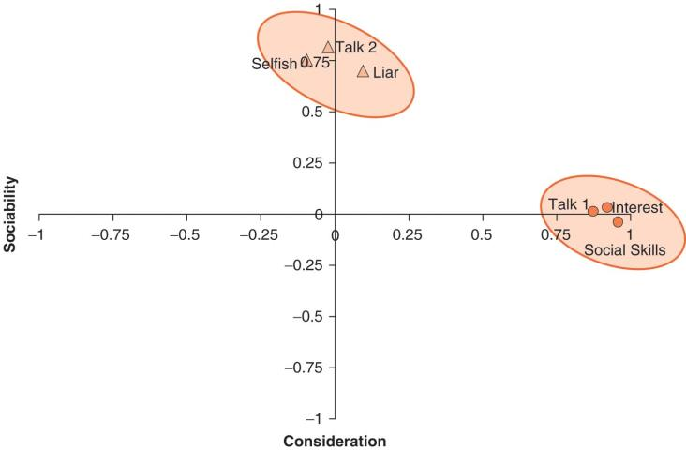
Graphical Representation of a factor plot
Note that each variable loads primarily on only one factor.
Loadings tell use about the relative contribution that a variable makes to a factor

Slide 26
Principal Component Analysis (PCA)
A transformation of the data that estimates as many components as there are manifest variables
PCA reduces
A set of highly correlated manifest variables
To a set of unrelated components
Arranged in descending order of importance
If PCA results in the first few components explaining a large amount of the variation we can without losing much information replace our manifest variables with our components.

Slide 27
Factor Analysis V Principal Components Analysis
FA attempts to achieve parsimony by explaining the maximum amount of common variance in a correlation matrix using the smallest number of explanatory constructs.
These ‘explanatory constructs’ are called factors.
PCA tries to explain the maximum amount of total variance in a correlation matrix.
It does this by transforming the original variables into a set of linear components.

Slide 28
Assumptions
A linear relationship exists between the latent variable and the manifest variables

Slide 29
Mathematical Equation
Note that there is no b0
The b values are called factor loadings
They can be interpreted as the correlation between the manifest variable and the factor
As with all correlations they range from -1 to +1
We should standardise our Xs so that our interpretation of the levels of correlation make sense

Slide 30
Mathematical Equation
For every case in our dataset we have the values of X but not of F
Therefore we cannot fit a regression line as we have done previously
But we can transform the relationships between the variables using a method of extraction to retrieve factors from the data

Slide 31
Loadings
Both FA and PCA are linear models in which loadings are used as weights.
These loadings can be expressed as a matrix
This matrix is called the factor matrix or component matrix (if doing PCA).
The assumption of FA(but not PCA) is that these algebraic factors represent real-world dimensions.
Variables | Factors
 | Sociability | Consideration
Talk 1 | 0.87 | 0.01
Social Skills | 0.96 | -0.03
Interest | 0.92 | 0.04
Talk 2 | 0.00 | 0.82
Selfish | -0.10 | 0.75
Liar | 0.09 | 0.70

Slide 32
Loadings
Correlation between a specific observed variable and a specific factor.
Higher values mean a closer relationship. They are equivalent to standardised regression coefficients (β weights) in multiple regression.
Higher the value the better.
Variables | Factors
 | Sociability | Consideration
Talk 1 | 0.87 | 0.01
Social Skills | 0.96 | -0.03
Interest | 0.92 | 0.04
Talk 2 | 0.00 | 0.82
Selfish | -0.10 | 0.75
Liar | 0.09 | 0.70
There is no definition of what constitutes a high or low factor loading.
The convention is that a loading of magnitude above 0.3 (irrespective of sign) are considered high.

Slide 33
Mathematical Representation of a factor plot
In our example there are two factors underlying the popularity construct: general sociability and consideration.
We can construct equations that describe each factor in terms of the variables that have been measured.
Sociability_{i} = b₁Talk 1_{i} +b₂Social Skills_{i} + b₃interest_{i} + b₄Talk 2 + b₅Selfish_{i} + b₆Liar_{i} + ε_{i}
Consideration_{i} = b₁Talk 1_{i} +b₂Social Skills_{i} + b₃interest_{i} + b₄Talk 2 + b₅Selfish_{i} + b₆Liar_{i} + ε_{i}

Slide 34
Mathematical Representation of a factor plot
The values of the “b’s” in the two equations differ, depending on the relative importance of each variable to a particular factor.
Sociability_{i} = 0.87Talk 1_{i} +0.96Social Skills_{i} + 0.92Interest_{i} + 0.00Talk 2 - 0.10Selfish_{i} + 0.09Liar_{i} + ε_{i}
Consideration_{i} = 0.01Talk 1_{i} - 0.03Social Skills_{i} + 0.04interest_{i} + 0.82Talk 2 + 0.75Selfish_{i} + 0.70Liar_{i} + ε_{i}
Replace values of b with the co-ordinate of each variable on the graph.
Ideally, variables should have very high b-values for one factor and very low b-values for all other factors.

Slide 35
Doing Factor Analysis: An Example (Andy Field)
Students often become stressed about statistics (RAQ) and the use of computers and/or R to analyze data.
Suppose we develop a questionnaire to measure this propensity (see sample items on the following slides; the data can be found in RAQ.dat).
Does the questionnaire measure a single construct?
Or is it possible that there are multiple aspects comprising students’ anxiety toward R?

Slide 36
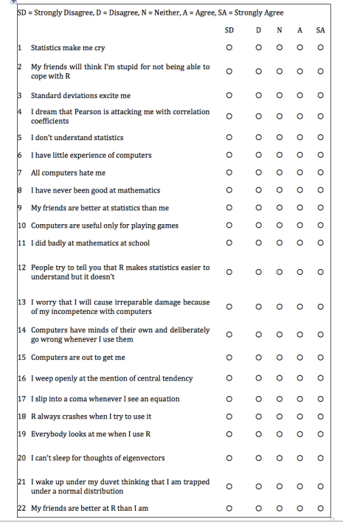
RAQ Questionnaire
Twenty Three Questions - Some of the questions

Slide 37
Initial Considerations
The quality of the data (GI⇒GO).
Sample size is important!
A sample of 300 or more will likely provide a stable factor solution, but depends on the number of variables and factors identified.
Sample to variable ratio N:p where N is no of cases and p is no of variables aim for 10:1
Correlations among the items should not be too low (less than .3) or too high (greater than .8), but the pattern is what is important.
Factors that have four or more loadings greater than 0.6 are likely to be reliable regardless of sample size.
Screen the correlation matrix, eliminate any variables that obviously cause concern

Slide 38
Step 1: Generate a correlation matrix (lots of ways)
#load data
raqData<-read.delim("raq.dat", header = TRUE)
#create a correlation matrix
raqMatrix<-cor(raqData)
round(raqMatrix, 2)
#Showing significance levels also
Hmisc::rcorr(as.matrix(raqData))
#Visualisation of correlations using circles
corrplot::corrplot(raqMatrix, method="circle")
#Visualisation using numbers
corrplot::corrplot(raqMatrix, method="number")
#Visualisation of significance levels at 0.05
res1 <- corrplot::cor.mtest(raqMatrix, conf.level = .95)
corrplot::corrplot(raqMatrix, p.mat = res1$p, sig.level = .05)
#Showing p-value for non-significant results
corrplot(raqMatrix, p.mat = res1$p, insig = "p-value")

Slide 39
Step 1: Generate a correlation matrix (lots of ways)
##Using ggcorrplot
p.mat <- ggcorrplot::cor_pmat(raqData)
ggcorrplot::ggcorrplot(raqMatrix, title = "Correlation matrix for RAQ data")
#Showing Xs for non-significant correlations
ggcorrplot::ggcorrplot(raqMatrix, title = "Correlation matrix for RAQ data", p.mat = p.mat, sig.level = .05)
#Showing lower diagonal
ggcorrplot::ggcorrplot(raqMatrix, title = "Correlation matrix for RAQ data", p.mat = p.mat, sig.level = .05, type="lower")
#Showing the co-efficients
ggcorrplot::ggcorrplot(raqMatrix, lab=TRUE, title = "Correlation matrix for RAQ data", type="lower")

Slide 40
Screen Correlation Matrix
The quality of analysis depends upon the quality of the data (GI⇒GO).
Test variables should correlate quite well
r > .3.
Avoid multicollinearity:
several variables highly correlated, r > .80.
Avoid singularity:
some variables perfectly correlated, r = 1.
Screen the correlation matrix, eliminate any variables that obviously cause concern.
Take a look at the matrix in the html accompanying this lecture.

Slide 41
Step 2: Generate Relevant Statistics
Checking for multicollinearity
Inspect determinant and check to see if it is greater than 0.00001
The Bartlett Test of Sphericity
Tests that your variables are correlated.
Compares the correlation matrix with a matrix of zero correlations (technically called the identity matrix, which consists of all zeros except the 1’s along the diagonal – all correlations are perfect).
You are looking for a statistically significant p value which suggests that they are related and a PCA/FA would be useful.
Highly unlikely for us to have obtained the observed correlation matrix from a population with zero correlation.

Slide 42
Step 2: Generate Relevant Statistics
Kaiser-Meyer-Olkin Measure of Sampling Adequacy (MSA)
Indicates the proportion of variance in your variables that might be caused by an underlying factor.
Doesn’t produce a p value
High values close to 1 suggest that PCA/FA might be useful
Values over 0.8 or over are considered strong
Anything less than 0.5 suggests that PCA/FA won’t be useful
Kaiser put together the following descriptors:
0.00 to 0.49 unacceptable.
0.50 to 0.59 miserable.
0.60 to 0.69 mediocre.
0.70 to 0.79 middling.
0.80 to 0.89 meritorious.
0.90 to 1.00 marvellous.

Slide 43
Step 2: Generate Relevant Statistics
#Bartlett's test
psych::cortest.bartlett(raqData)
psych:: cortest.bartlett(raqMatrix, n = 2571)
#Measure of Sampling Accuracy (execute one of these):
psych::kmo(raqData)
REdaS::KMOS(raqData)
#Determinant (execute one of these from the base package):
det(raqMatrix)
det(cor(raqData))

Slide 44
Initial Considerations – Is it possible?
Check the Determinant:
Indicator of multicollinearity
Should be greater than 0.00001
Check Kaiser–Meyer–Olkin (KMO):
Measures sampling adequacy (how well suited is your data to the dimension reduction)
Should be greater than .5
Indicates the proportion of variance in your variables that might be caused by an underlying factor.
Check Bartlett’s test of Sphericity:
Tests whether the R-matrix is an identity matrix
Should be significant at p < .05
We can see the correlations ourselves, this just confirms that it is possible to combine the variables because they are correlated.

Slide 45
Our Example RAQ
Determinant: 0.0005271037
KMO ReDAs: 0.9302245
KMO psych: 0.93
Bartlett:chi-square= 19334.49 p=0 df=253

Slide 46
Step 3: Do The Dimension Reduction
RAQ
In this case we are using all the variables so Principal Component Analysis is the function we need to apply
We also create a Scree plot which we will use later

Slide 47
FA/PCA
Principal Components Analysis (PCA)
This is a data reduction method, not a true factor analysis (as it analyses all of the variance of the variables) so attempts to extract same number of components as there are variables.
Factor Analysis
Need to choose a method of factor extraction
There are six extraction methods : unweighted least squares, generalized least squares, maximum likelihood, principal axis factoring, alpha factoring and image factoring
The general rule of thumb is:
If your data are normally distributed then use maximum likelihood (ML)
If your data are not normally distributed then use Principal Axis Factoring (PAF)

Slide 48
Step 3: Do the Dimension Reduction
#Principal Component Analysis
#On raw data using principal components analysis, nfactors is set to the number of variables we expect to get out which is equal to the number going in.
pc1 <- principal(raqData, nfactors = 23, rotate = "none")
pc1 <- principal(raqData, nfactors = length(raqData), rotate = "none")
plot(pc1$values, type = "b") #scree plot

Slide 49
Step 3: Do the Dimension Reduction
#Factor Analysis
#Principal Axis Factoring
pc3 <- fa(raqMatrix, nfactors=4, obs=NA, n.iter=1, rotate="varimax", fm="pa")
psych::print.psych(pc3,cut=0.3, sort=TRUE)
fa.graph(pc3)
fa.sort(pc3$loading)
fa.diagram(pc3)#create a diagram showing the factors and how the manifest variables load
plot(pc3$values, type = "b") #scree plot

Slide 50
How many variables do we want?
How many latent variables do we want to keep?
The common method is to select factors with Eigenvalues greater than 1 option
Eigenvalue = the variance of a component or factor
Kaiser (1960) recommends retaining all factors with eigenvalues greater than 1.
Based on the idea that eigenvalues represent the amount of variance explained by a factor and that an eigenvalue of 1 represents a substantial amount of variation.
Jolliffe (1972; 1986) reported that Kaiser’s criterion is too strict and recommended retaining factors with eigenvalues more than 0.7.

Slide 51
Extracting the factors
If we have n manifest variables in our analysis, PCA transforms the data such that the total variance of the components n will be redistributed among the components
The first will have the largest eigenvalue
The next the next highest etc.
If the eigenvalue is divided by n the result is the proportion of variance explained by that factor
A rule of thumb is to retain in the final solution all factors with an Eigenvalue greater than one

Slide 52
Retrieving our eigenvalues
pc1$values #output eigenvalues
#Another way to look at Eigen values plus variance explained
pcf=princomp(raqData)
factoextra::get_eigenvalue(pcf)

Slide 53
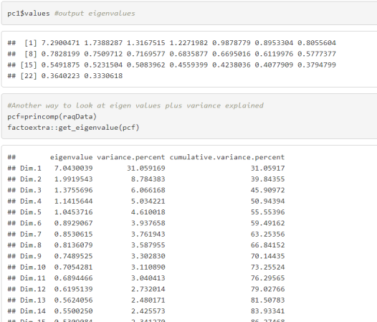
Our example

Slide 54
Finding Factors
Cattell (1966) suggests using the ‘point of inflexion’ of the scree plot to decide how many factors to extract

Slide 55
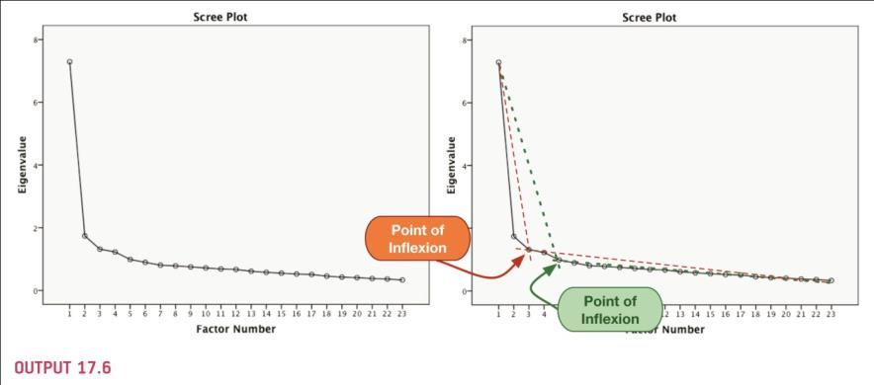
Scree Plot
Look for change in shape of the plot – points of inflexion, only factors/components above this point are retained
Notes:
55

Slide 56
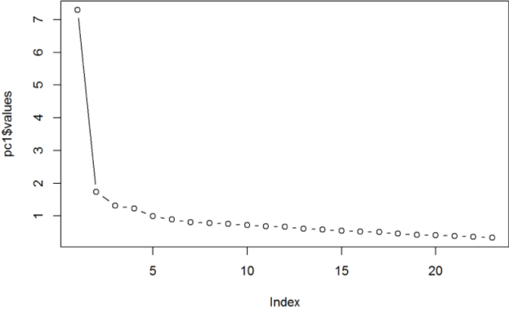
Our Example

Slide 57
Factor/Component Extraction
Which Rule?
Use Kaiser’s Extraction when
less than 30 variables, communalities after extraction > 0.7.
sample size > 250 and mean communality ≥ 0.6.
Scree plot is good if sample size is > 200.

Slide 58
Total Variance Explained
Indicates how much of the variability in the data has been modelled by the extracted factors

Slide 59

Variance Explained
Indicates how much of the variability in the data has been modelled by the extracted factors.
Factor/Component 11 explains 31.69%,
Factor/Component 1+2 explain 39.26% etc.
Together the 4 uncorrelated factors summarise 50.32% of the information in the original inter-related variables
Calculated by dividing Eigenvalue by the number of factors/components
Notes:
59

Slide 60
In R
pc1$Vaccounted#Variance accounted for

Slide 61
Deciding on Factors/Components to Retain
Need to look at both loadings and communalities
Strong data
Uniformly high communalities (>0.8 is strong but it is more likely to be in the region of 0.4-0.7).
Item loadings above 0.3 is acceptable.
None, or few, cross loadings (a variable loads higher than 0.32 on two or more factors)
Several variables loading on to each factor/component (factor loadings of 0.3 or greater).
A factor/component with fewer than 3 items is typically weak.

Slide 62
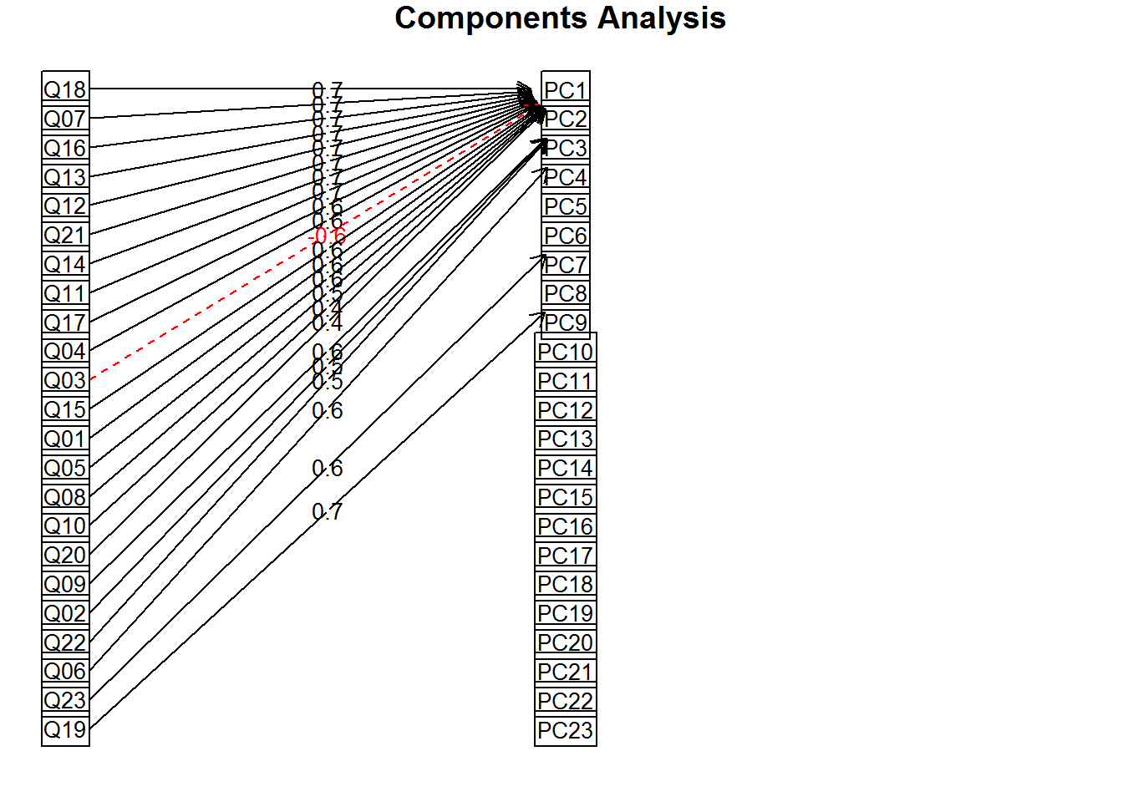
Loadings (PA1=Dim1=Component 1)

Slide 63
Communalities
b is the correlation between the manifest variable and the factor or component
The square of the correlation is the proportion of variance in the manifest variable that can be explained by the factor
If we square and sum all the factor loadings for a manifest variable across the factor equations we have the communality
How much of the variance in the manifest variable is accounted for by the combination of factors

Slide 64
Communalities
In the initial PCA because we have as many components/factors as manifest variables this will be 1
If we drop components it will be less than 1
This will then provide an indication of how much each manifest variable contributes to our reduced solution.

Slide 65
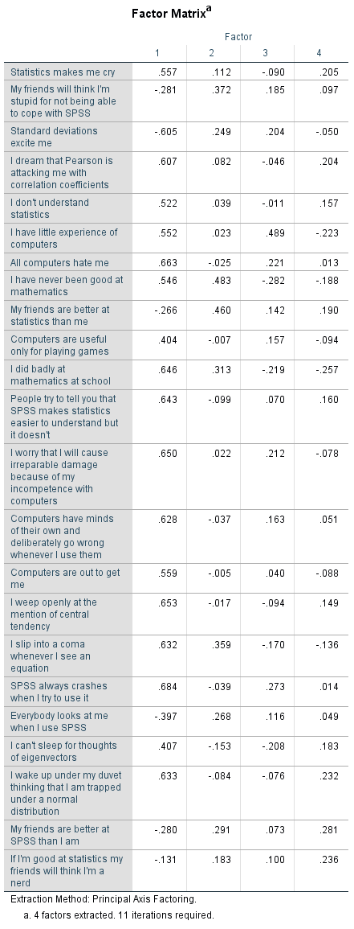
Factor/Component Matrix - Loadings
Called component matrix for PCA
Correlation between a specific manifest/observed variable and a specific factor
These are the b’s for the factor equations

Slide 66
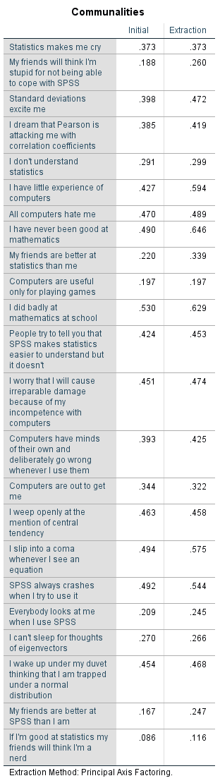
Communalities
Communality = sum of the square of the loading of a variable across a component/factor
How much variance in the manifest/observed variables is accounted for by the factors found

Slide 67
Communalities
 | 1 | 2 | 3 | 4
I wake up under my duvet thinking that I am trapped under a normal distribution | 0.594 | 0.264 | 0.149 | 0.15
 | Extraction
I wake up under my duvet thinking that I am trapped under a normal distribution | . 467
Take Q1 Statistics Make Me Cry
Communality=.594²+.264² +.149² +.15 ^{2=.}467

Slide 68
Step 4: Factor Rotation
Given the communalities, there are multiple solutions for loadings that result in the same communality and correlation
“Correct” answer is dependent upon interpretability
To aid interpretation it is possible to maximise the loading of a variable on one factor while minimising its loading on all other factors
The aim of rotation is to clarify the data structure
You cannot apply a rotation if only one factor emerges
Aim to have non-zero loadings on each factor for only some of the variables
Rotation reallocates the variable variance among the factors
Shifts variance from earlier factors to later ones
Interpretation shifts from unrotated factors delineating the most comprehensive data patterns to factors delineating the distinct groups of interrelated data.

Slide 69
Rotation – Why?
The factor patterns define decreasing amounts of variation in the data.
Each pattern may involve all or most of the variables and the variables may have moderate or high loadings for several factor patterns
To uncover the first pattern, a factor is fitted to the data to account for the greatest regularity;
Each successive factor is fitted to best define the remaining regularity.
The result of this is that the first unrotated factor may be located between independent clusters of interrelated variables.
These clusters cannot be distinguished in terms of their loadings on the first factor, although they will have loadings different in sign on the second and subsequent factors
Each factor is rotated until it defines a distinct cluster of interrelated variables.

Slide 70
Geometric Rotation
Factor extraction equivalent to coordinate planes
Factors are the axes
Length of the line from the origin to the variable coordinates is equal to the communality for that variable
Orthogonal Factors are at right angles
Factor loadings are found by dropping a line from the variable coordinates to the factor at a right angle
Repositioning the axes changes the loadings on the factor but keeps the relative positioning of the points the same

Slide 71
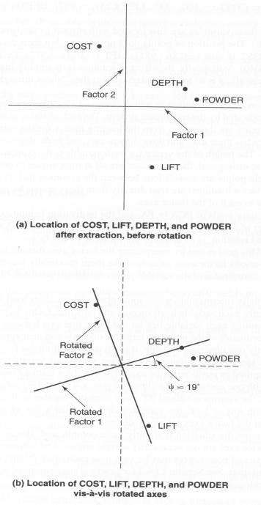
Geometric Rotation

Slide 72
Orthogonal Rotation
Oblique Rotation
Rotating the axes - Aim is to make the location of the axes fit the actual data points better. Move to a position that encompasses the actual data points better overall. This will hopefully make them more interpretable.

Slide 73
Rotation
#Rotation PCA
pc2 <- principal(raqData, nfactors = 4, rotate = "varimax")#Extracting 4 factors
print.psych(pc2, cut = 0.3, sort = TRUE)
#Get the output as you would for initial solution

Slide 74
Rotated Factor Matrix(FA)
Check the factor loadings after rotation
Need to consider rotated factor loadings before making a final decision
Notes:
74

Slide 75
Step 4: Reliability Analysis
A Cronbach’s alpha measurement of consistency tells you how consistently the variables behave as a scale.
Internal consistency refers to the general agreement between multiple items (often Likert scale items) that make-up a composite score of a survey measurement of a given construct.
This agreement is generally measured by the correlation between items.
If it’s high (say .80 or .90), then we probably have one factor/component

Slide 76
Interpreting Cronbach’s Alpha
Depends on the number of items
More questions = bigger α
Low numbers of items (<10) can result in low levels of alpha
Treat Subscales separately
Remember to reverse score reverse phrased items!
If not, α is reduced and can even be negative

Slide 77
Reliability:
Cronbach’s Alpha
Ranges from 0 (no reliability) to 1 (complete reliability)
Should be .7 or greater to be considered “reliable”.
The closer Cronbach’s alpha coefficient is to 1.0 the greater the internal consistency of the items in the scale.
George and Mallery provide the following rules of thumb:
> .9 – Excellent
> .8 – Good
> .7 – Acceptable
> .6 – Questionable
> .5 – Poor and
< .5 – Unacceptable
George and Mallery, SPSS for Windows step by step: A simple guide and reference. 11.0 update (4th ed.)

Slide 78
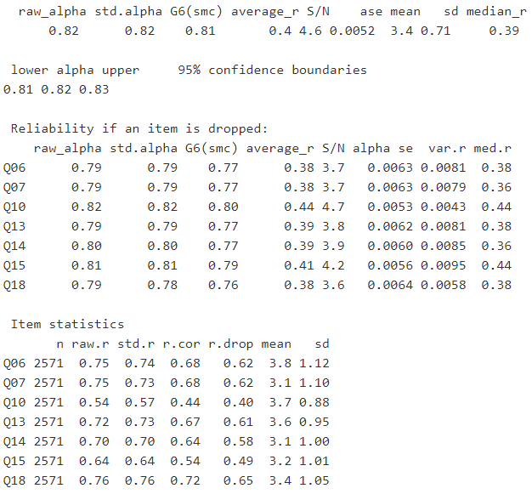
Item-Total Statistics: Fear of Computers sub-scale
Alpha above .7 is strong, .6 is acceptable
Notes:
78

Slide 79
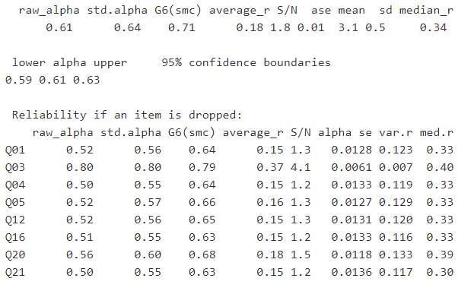
Item-Total Statistics: Fear of Statistics sub-scale
Look for items that would improve alpha if removed
Notes:
79

Slide 80
In R
#Reliability analysis
computerFear<-raqData[,c(6, 7, 10, 13, 14, 15, 18)]
statisticsFear <- raqData[, c(1, 3, 4, 5, 12, 16, 20, 21)]
mathFear <- raqData[, c(8, 11, 17)]
peerEvaluation <- raqData[, c(2, 9, 19, 22, 23)]
alpha(computerFear)
alpha(statisticsFear, keys = c(1, -1, 1, 1, 1, 1, 1, 1))
alpha(mathFear)
alpha(peerEvaluation)
alpha(statisticsFear) #for illustrative purposes

Slide 81
Reporting the Results
A principal component analysis (PCA) was conducted on the 23 items with orthogonal rotation (varimax). Bartlett’s test of sphericity, Χ2(253) = 19334.49, p< .001, indicated that correlations between items were sufficiently large for PCA. An initial analysis was run to obtain eigenvalues for each component in the data. Four components had eigenvalues over Kaiser’s criterion of 1 and in combination explained 50.94% of the variance. The scree plot was slightly ambiguous and showed inflexions that would justify retaining either 2 or 4 factors.
Given the large sample size, and the convergence of the scree plot and Kaiser’s criterion on four components, four components were retained in the final analysis. Component 1 represents a fear of computers, component 2 a fear of statistics, component 3 a fear of math, and component 4 peer evaluation concerns.
The fear of computers, and fear of math subscales of the RAQ all had high reliabilities, all Cronbach’s α = .82. The fear of statistics had an acceptable reliability of Cronbach’s α = .61 of However, the fear of negative peer evaluation subscale had a relatively low reliability, Cronbach’s α= .57.

Slide 82
The End?
Describe Factor Structure/Reliability
What items should be retained?
What items did you eliminate and why?
Application
How does it fit in with your theory?
Where will your questionnaire be used? (if you are this is your research focus)

Slide 83
Exploratory Factor Analysis (EFA)
Is a variable reduction technique which identifies the number of latent constructs and the underlying factor structure of a set of variables
Hypothesizes an underlying construct, a variable not measured directly
Estimates factors which influence responses on observed variables
Allows you to describe and identify the number of latent constructs (factors)
Includes unique factors, error due to unreliability in measurement

Slide 84
Exploratory Factor Analysis (EFA)
Traditionally has been used to explore the possible underlying factor structure of a set of measured variables without imposing any preconceived structure on the outcome
Since measurement is not perfect, error or unreliability is estimated and specified explicitly in the diagram.
Factor loadings (parameter estimates) help interpret factors.
Loadings are the correlation between observed variables and factors
are standardized regression weights if variables are standardized (weights used to predict variables from factor), and are path coefficients in path analysis.
Standardized linear weights represent the effect size of the factor on variability of observed variables.

Slide 85
Principal Component Analysis (PCA)
Is a large sample procedure
Is a variable reduction technique
Is used when variables are highly correlated
Reduces the number of observed variables to a smaller number of principal components which account for most of the variance of the observed variables
The total amount of variance in PCA is equal to the number of observed variables being analyzed.
In PCA, observed variables are standardized,
e.g., mean=0, standard deviation=1, diagonals of the matrix are equal to 1.

Slide 86
Principal Component Analysis (PCA)
The amount of variance explained is equal to the trace of the matrix (sum of the diagonals of the decomposed correlation matrix).
The number of components extracted is equal to the number of observed variables in the analysis.
The first principal component identified accounts for most of the variance in the data.
The second component identified accounts for the second largest amount of variance in the data and is uncorrelated with the first principal component and so on.
Components accounting for maximal variance are retained while other components accounting for a trivial amount of variance are not retained.
Eigenvalues indicate the amount of variance explained by each component.
Eigenvectors are the weights used to calculate components scores

Slide 87
Principal Component Analysis (PCA)
A transformation of the data that estimates as many components as there are manifest variables
Constraints
The sum of squared factor loadings is constrained to be 1
The components are to be uncorrelated
The coefficient must be 0
Referred to in factor analysis as being orthogonal (at right angles to each other)
The first component must account for the maximum amount of variance possible
The second for the largest amount of the variance left after the first component and so on

Slide 88
PCA and EFA Requirements
Measurement scale is interval or ratio level (or ordinal)
Random sample
At least 5 observations per observed variable and at least 100 observations in total required.
Larger sample sizes are recommended for more stable estimates, 10-20 observations per observed variable
Over sample to compensate for missing values
Linear relationship between observed variables

Slide 89
PCA
Not based on any causative relationship between the components and the manifest variables.
It is not proposing that the components are latent variables
It is simply rearranging the data under the given constraints.

Slide 90
Factor Analysis v Principal Component Analysis
Common variance
variance shared with other variables (communality)
Unique variance
variance associated with a specific variable and not explained by correlation with other variables
Error variance
variance also unexplained by correlation with other variables due to factors such as measurement error or unreliability in data gathering

Slide 91
Factor Analysis v Principal Component Analysis
Both attempt to produce a smaller number of linear combinations of original variables that captures or accounts for most of the variability in the pattern of correlations
In PCA
Assumes all the variance is common
There is little unique or error variance – it is a very small part of the total
Objective is to identify minimum number of factors to capture the total amount of variation
In FA
Factors are estimated using a mathematical model
Only the shared/common variance is used
Objective is to identify latent constructs represented in the original variables

Slide 92
Factor Analysis v Principal Component Analysis
Results from PCA and EFA may be similar
When number of variables exceeds 30 or
Communalities exceed .6 for most variables
Confirmatory factor analysis
Not an exploratory technique
Requires hypotheses regarding factors and variables

Slide 93
PCA V EFA
Similarities
Correlated observed variables
Sample size requirements
Measures of adequacy
Analysis of factors requires decisions regarding factor retention, rotation and interpretation
Differences
Variance
PCA Models total variance
EFA Models common variance only
What is modelled
PCA Models factors in terms of observed variables
EFA Models observed variables in terms of factors
Objective
PCA Objective is typically data reduction
EFA Objective is typically to identify latent factors

Slide 94
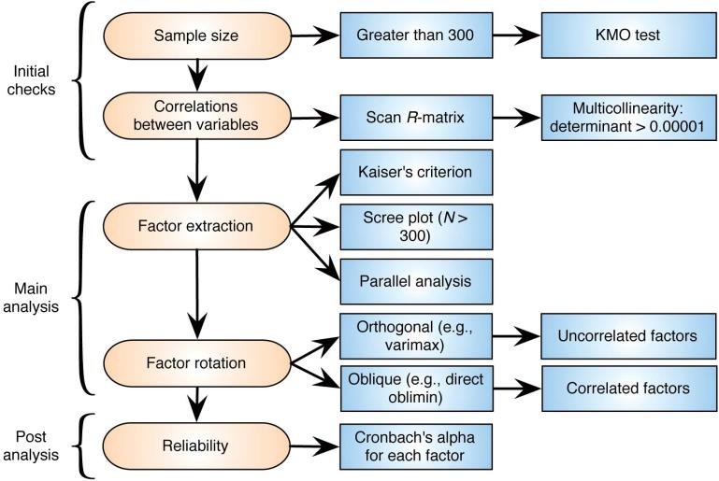
Procedure for factor analysis & PCA

